Slide 1

Automated System for University Exam Scheduling
Project Code: 26-1-D-12
Presented by: Alon Dahan Karyn Arama
Supervised by: Dr. Julia Sheidin Dr. Avital Shulner Tal

Slide 2

Current State
Current Reality
The scheduling process is done manually using fragmented Excel sheets and personal intuition.
The Struggle
Having to manually cross-reference holidays, fast days, specific lecturer gaps, different curriculums and overlapping exams which is incredibly time consuming.
1

Slide 3
Why We Need Automation
Manual & Disorganized
The process is entirely manual, relying on fragmented Excel spreadsheets and "internal knowledge" that isn't written down.
Wasted Time
We are wasting valuable administrative time on a task that a computer can solve in seconds.
Impossible Conflicts
Without an algorithm, it’s hard to tell if a manual change creates an impossible situation for the rest of the exams.
2

Slide 4
Work Flow
Step 1
Conducted a literature review to compare algorithmic approaches.
Step 2
Performed interviews and observations with Ora
Step 3
Build a Prototype according to the insights
Step 4
Present the Prototype to Ora for feedback and improvements
3

Slide 5
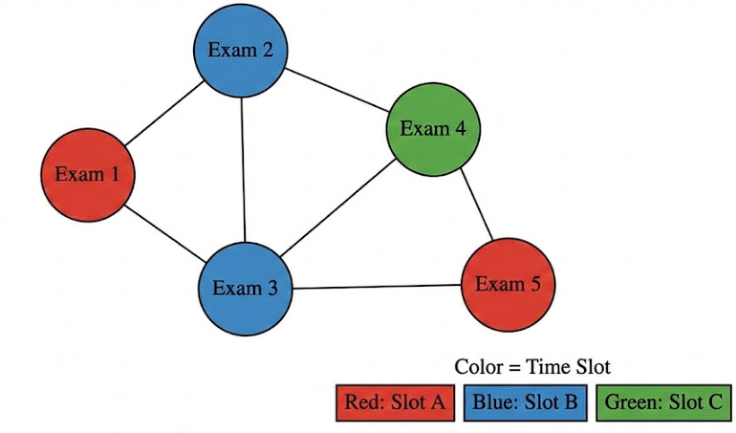
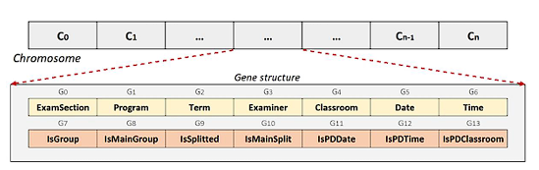
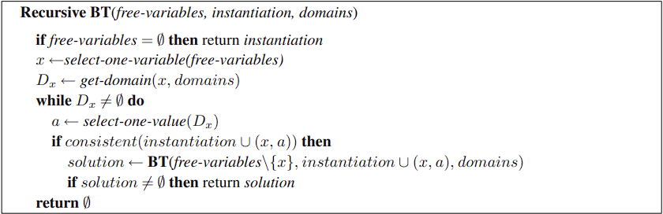
Algorithmic Approaches
Heuristics
Such as Graph Coloring.
They are inexpensive and quick but greedy and prone to getting stuck in local optima.
Meta-heuristics
Such as Genetic Algorithms (GA) are great for these problems but require complex parameter tuning and are not guaranteed to find a feasible solution.
Constraint Programming (CSP)
Unlike GA, it was designed to prove feasibility but suffers from dealing with large data sets.
4

Slide 6

Interview Findings
We held an interview with the Assistant Head of Department, Ora
Intuition Based Rules: Scheduling decisions rely on "implicit heuristics," such as manually spacing out exams for courses with high failure rates.
Faculty Constraints: Ora manually ensures gaps for lecturers, specifically prioritizing the constraints of permanent staff members.
Manual Synchronization: Exams shared with other departments must be manually coordinated to happen at the exact same time.
Re-shuffle: An option to re-shuffle exams, manually and automatically.
5

Slide 7

Proposed Solution
Our solution is a web-based system with CP-SAT as our algorithm.
CP-SAT stands for Constraint Programming – Satisfiability.
It looks for a feasible answer that satisfies every single rule we define for it and it has three main concepts.
Filtering
(DR)
Optimization
(LNS)
Backtracking
(CDCL)
6

Slide 8

Project Goals
Create a system that automatically weighs all Hard Constraints.
Streamline the scheduling workflow to reduce human error and free up significant administrative time.
Ensure synchronization for cross departmental exams and compliance with college wide academic policies.
Provide an initial automated schedule while allowing the administrator to perform manual "re-shuffles" for secondary adjustments.
Ensure 100% adherence to institutional rules to prevent logistical failures like exam overlaps or holiday violations.
7

Slide 9
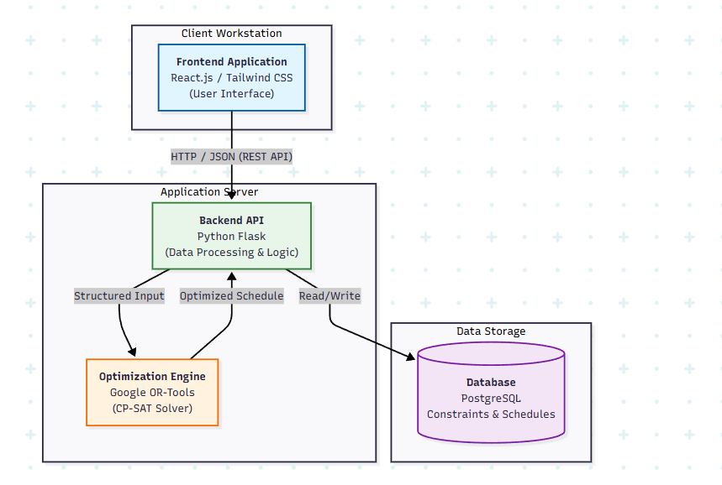
System Architecture
8

Slide 10
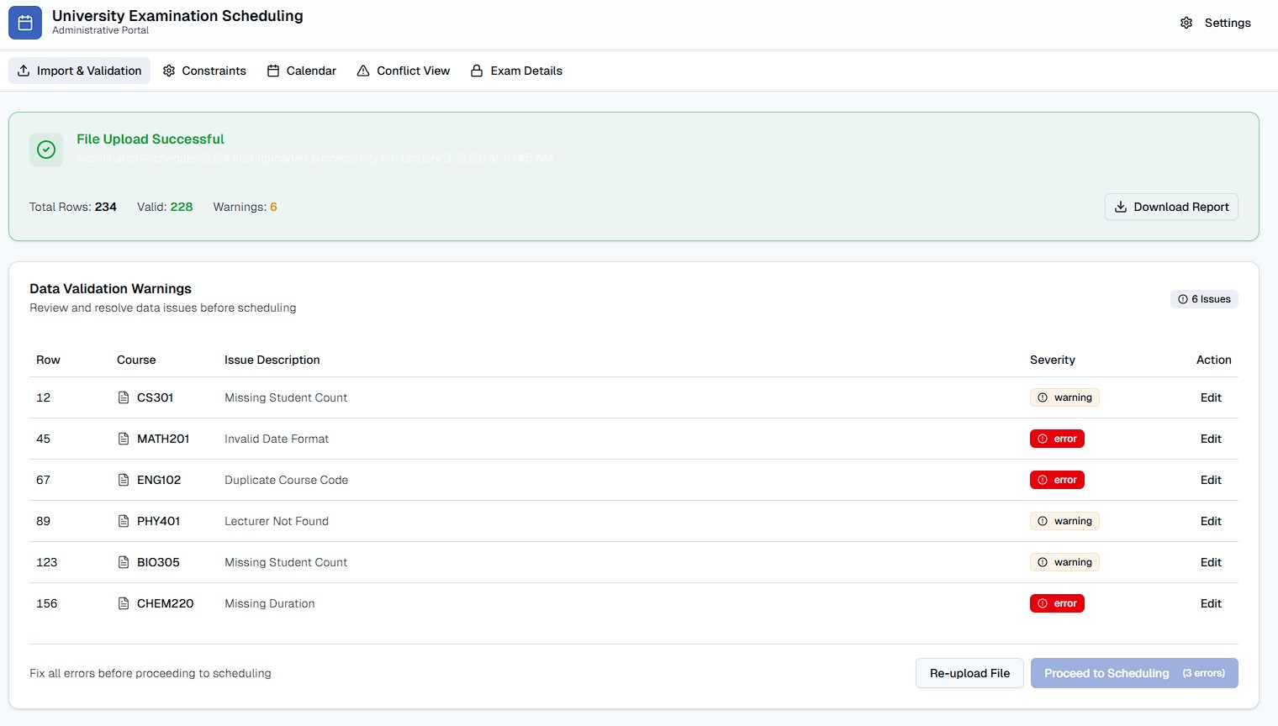
Prototype
File Upload Of Constraints And Preview Of Warnings.
9

Slide 11
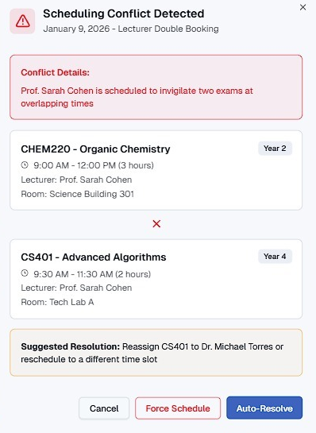
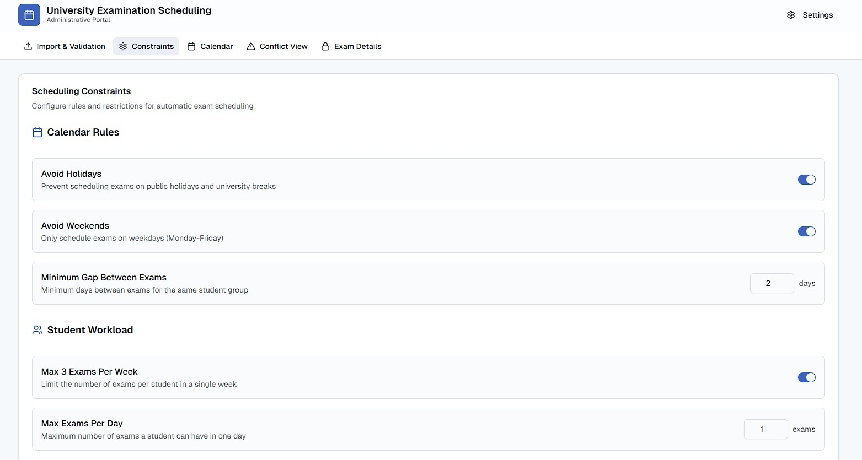
Prototype
Constraint Alignment
Conflict Preview
10

Slide 12
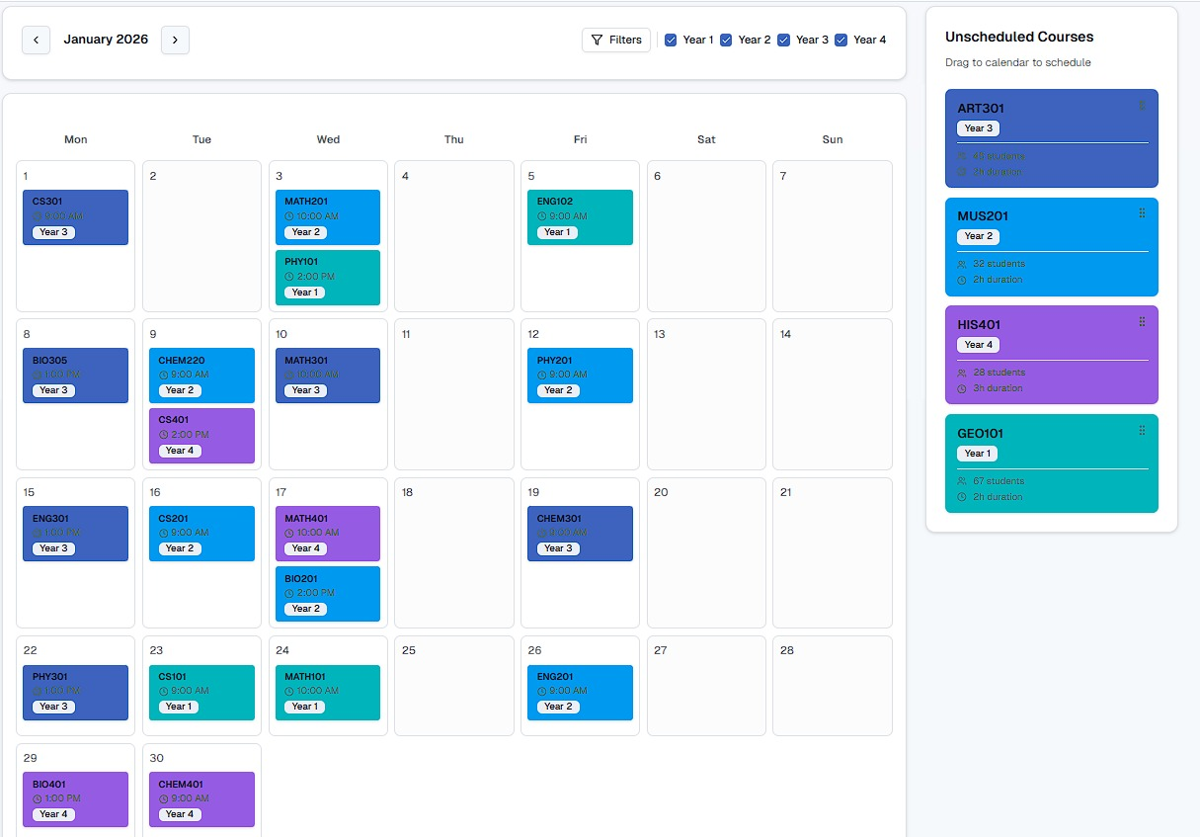
Prototype
11
Main Month Schedule Preview

Slide 13

Project Success Challenges
Translating real-world constraints into a formal model.
Ensuring feasibility under strict hard constraints.
Maintaining performance for an NP-hard problem.
Synchronizing cross-departmental exams.
Providing an intuitive, user-friendly interface.
12

Slide 14
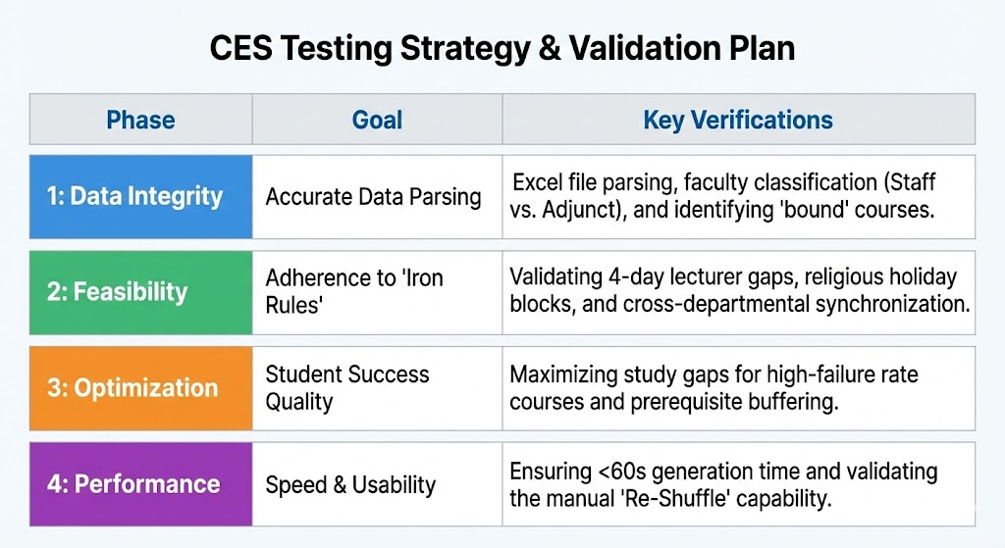
Testing Strategy
13

Slide 15



Success Metrics
Achieving 100% compliance with all "Hard Constraints" (e.g., no double-booked faculty or exams on holy days)
Generating a complete, valid initial schedule for approximately 50 courses in 60 seconds or less
Improving schedule quality, such as creating better study gaps for students, compared to historical manual versions
14

Slide 16


Thank You
Questions & Discussion
Team: Karyn Arama , Alon Dahan
Supervised by: Dr. Julia Sheidin , Dr. Avital Shulner Tal
Project Code: 26-1-D-12

